Slide 1
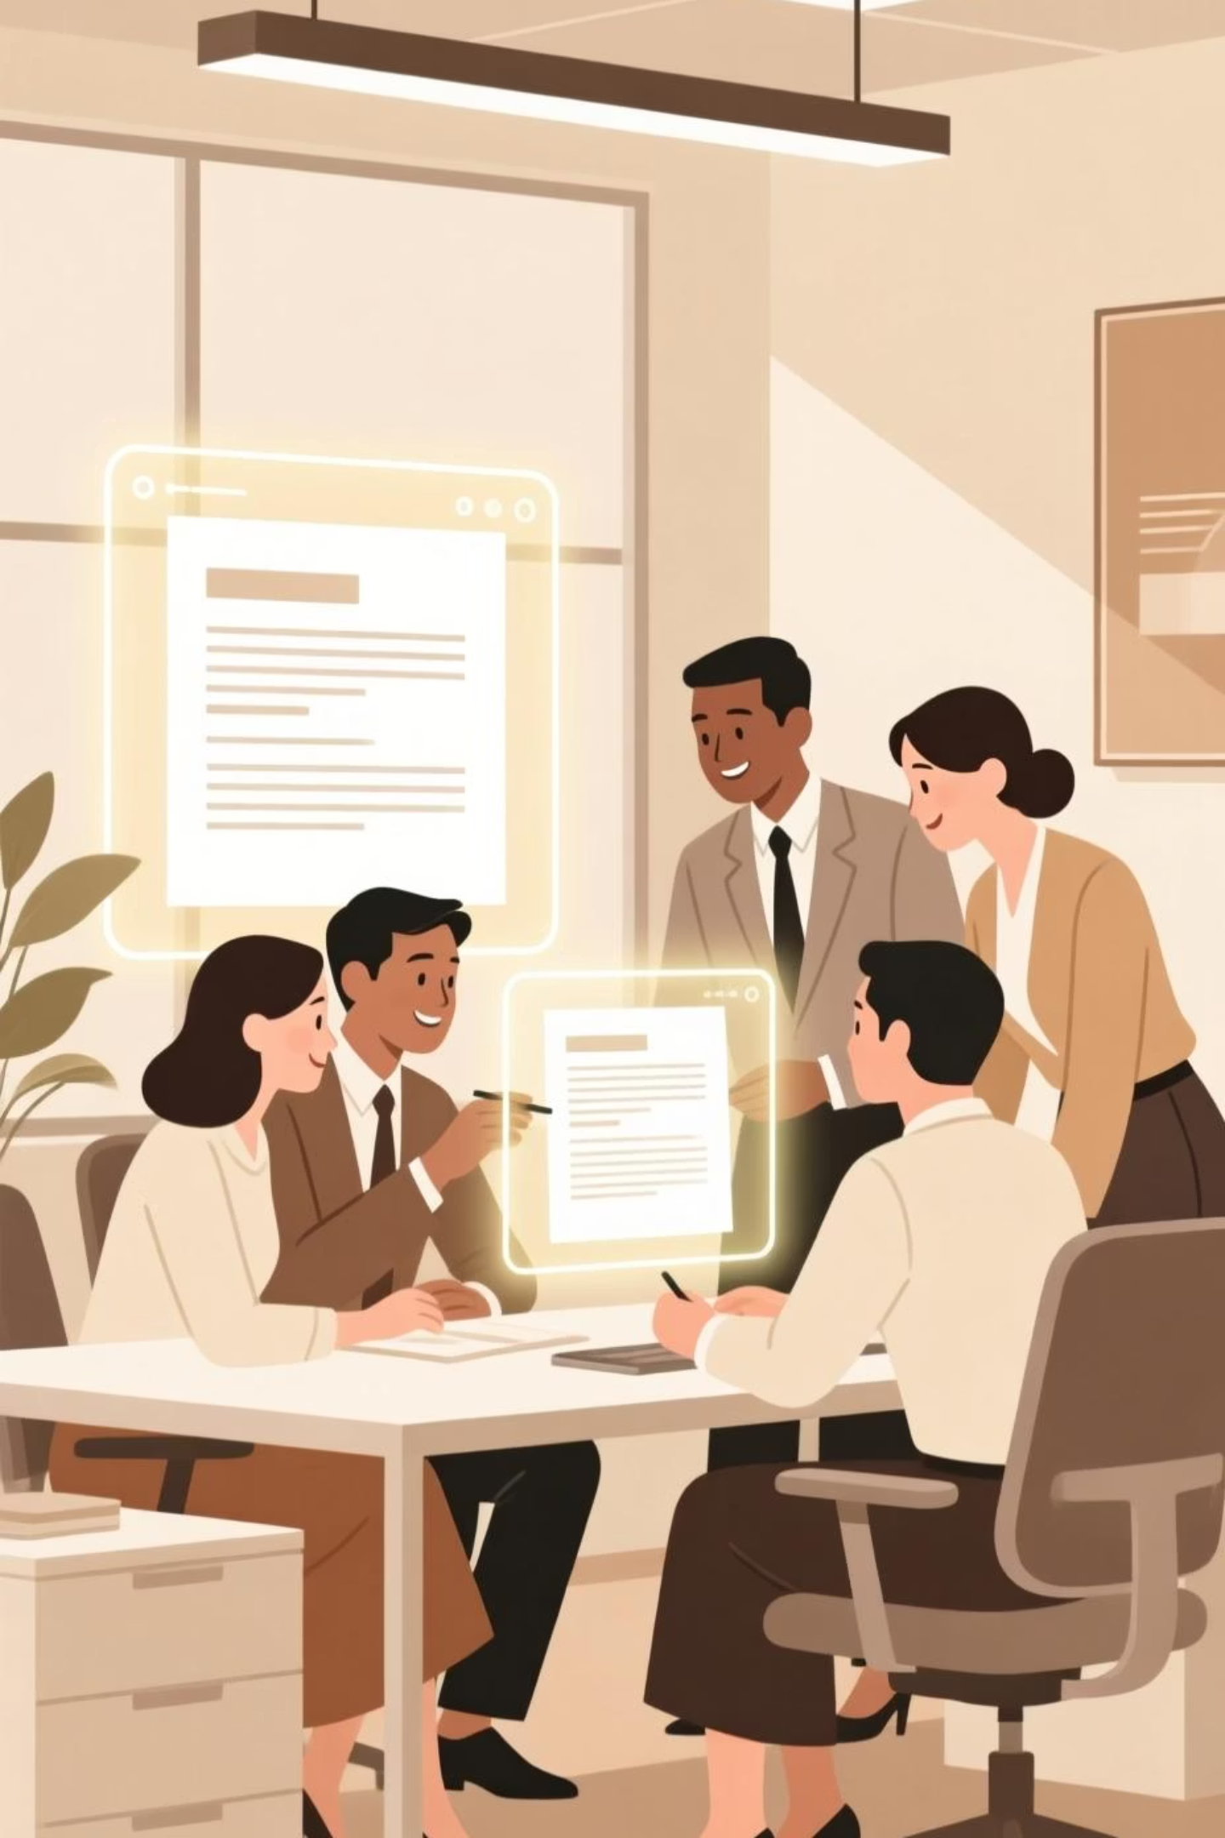
Real-Time Collaborative Document Platform
Empowering seamless teamwork and efficient document management for the modern workforce.

Slide 2

Project Overview: Building a Collaborative Future
Our mission is to develop a cutting-edge platform enabling multiple users to work on the same document simultaneously, ensuring smooth and conflict-free editing.

Slide 3



Core Functionality: Real-Time Editing
Multi-User Access
Smooth Editing
Conflict-Free
Allow many people to type at once.
Ensure a fluid and responsive user experience.
Prevent editing clashes and data loss.
This ensures that even with high concurrency, the platform remains stable and reliable.

Slide 4
Robust Version Control: Git-Like System
Branching
Merging
Rollback
Create separate lines of development for features or edits.
Combine changes from different branches seamlessly.
Revert to previous versions whenever needed.
This system provides unparalleled flexibility and safety for document revisions.

Slide 5



Scalability for Any Team Size
1
Small Teams
2
Medium Teams
3
Large Enterprises
Our platform is built to accommodate teams of any size, from small startups to large corporations, ensuring consistent performance and reliability.

Slide 6
Key Benefits
Increased Productivity
Improved Collaboration
Enhanced Document Security
Simultaneous editing reduces bottlenecks and speeds up work.
Seamless sharing and feedback foster better teamwork.
Robust version control protects against data loss and errors.

